Slide 1
2017 Annual Report Snippets
NSDUH, SAMHSA, USA DHHS
Selected Trends
https://www.samhsa.gov/data/report/slides-2017-nsduh-annual-national-report

Slide 2
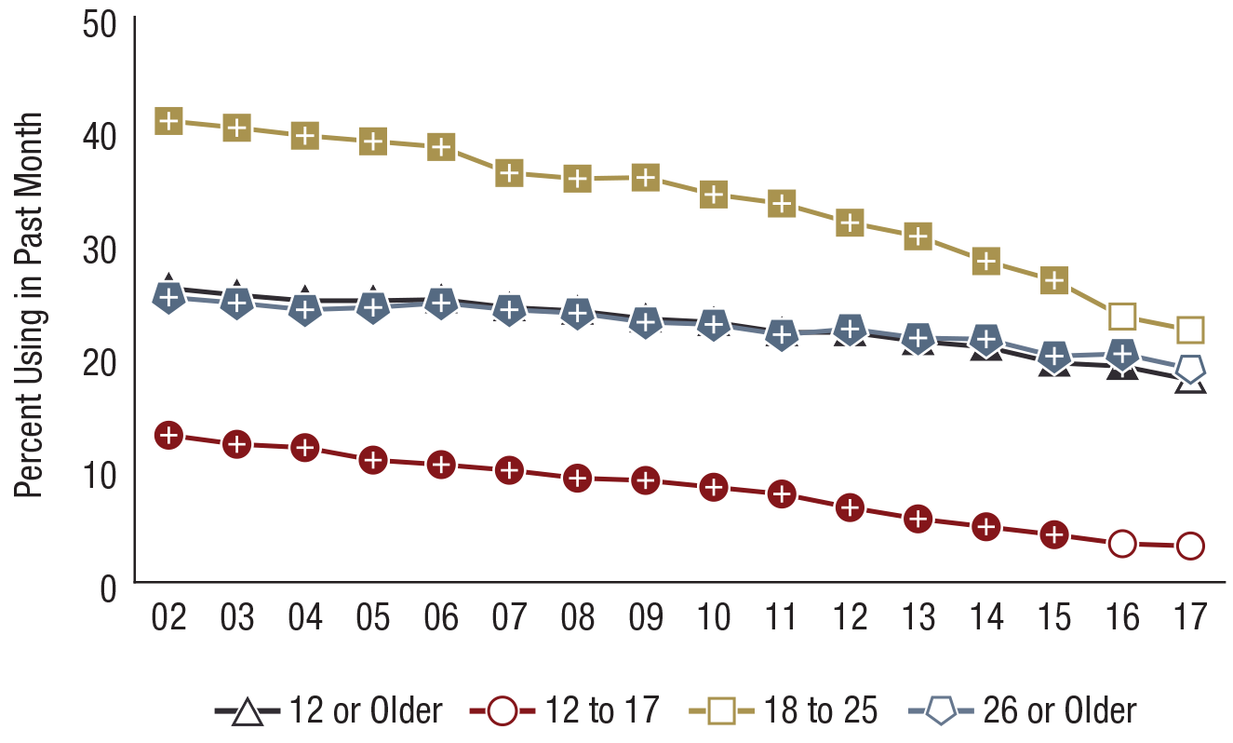
Past Month Cigarette Use among People Aged 12 or Older, by Age Group: Percentages, 2002-2017
FFR1.02
Age Group | 2002 | 2003 | 2004 | 2005 | 2006 | 2007 | 2008 | 2009 | 2010 | 2011 | 2012 | 2013 | 2014 | 2015 | 2016 | 2017
12 or Older | 26.0⁺ | 25.4⁺ | 24.9⁺ | 24.9⁺ | 25.0⁺ | 24.3⁺ | 24.0⁺ | 23.3⁺ | 23.0⁺ | 22.1⁺ | 22.1⁺ | 21.3⁺ | 20.8⁺ | 19.4⁺ | 19.1⁺ | 17.9
12 to 17 | 13.0⁺ | 12.2⁺ | 11.9⁺ | 10.8⁺ | 10.4⁺ | 9.9⁺ | 9.2⁺ | 9.0⁺ | 8.4⁺ | 7.8⁺ | 6.6⁺ | 5.6⁺ | 4.9⁺ | 4.2⁺ | 3.4 | 3.2
18 to 25 | 40.8⁺ | 40.2⁺ | 39.5⁺ | 39.0⁺ | 38.5⁺ | 36.2⁺ | 35.7⁺ | 35.8⁺ | 34.3⁺ | 33.5⁺ | 31.8⁺ | 30.6⁺ | 28.4⁺ | 26.7⁺ | 23.5 | 22.3
26 or Older | 25.2⁺ | 24.7⁺ | 24.1⁺ | 24.3⁺ | 24.7⁺ | 24.1⁺ | 23.8⁺ | 23.0⁺ | 22.8⁺ | 21.9⁺ | 22.4⁺ | 21.6⁺ | 21.5⁺ | 20.0⁺ | 20.2⁺ | 18.9

Slide 3
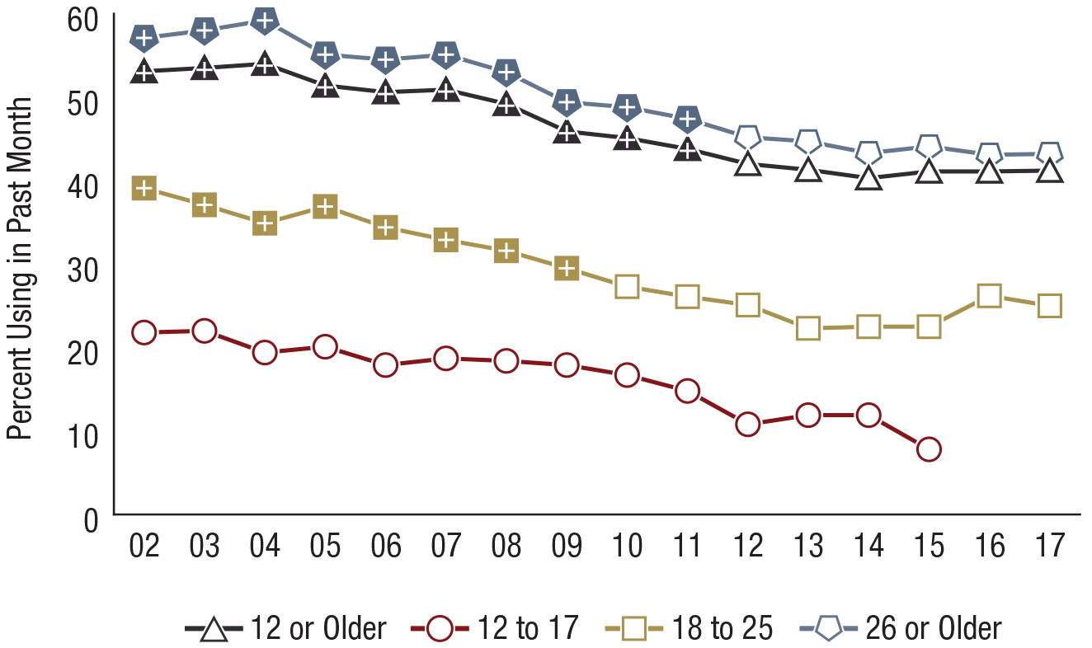
Smokers of One or More Packs of Cigarettes per Day among Past Month Daily Cigarette Smokers Aged 12 or Older, by Age Group: Percentages, 2002-2017
FFR1.04
* Low precision; no estimate reported.
Age Group | 2002 | 2003 | 2004 | 2005 | 2006 | 2007 | 2008 | 2009 | 2010 | 2011 | 2012 | 2013 | 2014 | 2015 | 2016 | 2017
12 or Older | 53.1⁺ | 53.5⁺ | 54.0⁺ | 51.4⁺ | 50.6⁺ | 50.9⁺ | 49.2⁺ | 45.9⁺ | 45.1⁺ | 43.8⁺ | 42.0 | 41.3 | 40.3 | 41.1 | 41.1 | 41.2
12 to 17 | 21.8 | 22.0 | 19.4 | 20.1 | 17.9 | 18.7 | 18.4 | 17.9 | 16.7 | 14.8 | 10.8 | 11.9 | 11.9 | 7.8 | * | *
18 to 25 | 39.1⁺ | 37.1⁺ | 34.9⁺ | 36.9⁺ | 34.4⁺ | 32.9⁺ | 31.6⁺ | 29.5⁺ | 27.3 | 26.1 | 25.1 | 22.3 | 22.5 | 22.5 | 26.2 | 25.0
26 or Older | 57.1⁺ | 58.0⁺ | 59.2⁺ | 55.1⁺ | 54.5⁺ | 55.1⁺ | 53.0⁺ | 49.4⁺ | 48.8⁺ | 47.4⁺ | 45.2 | 44.7 | 43.3 | 44.1 | 43.1 | 43.2

Slide 4
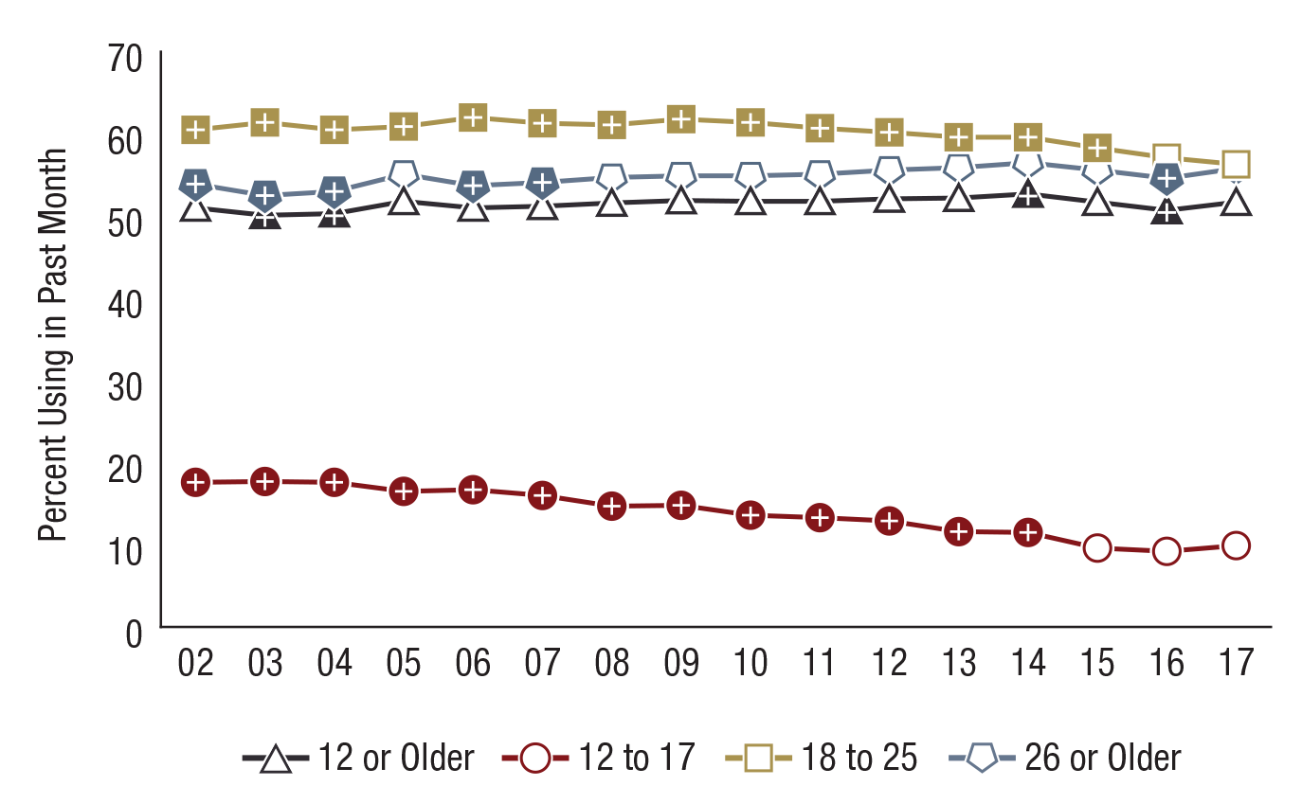
Past Month Alcohol Use among People Aged 12 or Older, by Age Group: Percentages, 2002-2017
FFR1.06
Age Group | 2002 | 2003 | 2004 | 2005 | 2006 | 2007 | 2008 | 2009 | 2010 | 2011 | 2012 | 2013 | 2014 | 2015 | 2016 | 2017
12 or Older | 51.0⁺ | 50.1⁺ | 50.3⁺ | 51.8 | 51.0 | 51.2 | 51.6 | 51.9 | 51.8 | 51.8 | 52.1 | 52.2 | 52.7⁺ | 51.7 | 50.7⁺ | 51.7
12 to 17 | 17.6⁺ | 17.7⁺ | 17.6⁺ | 16.5⁺ | 16.7⁺ | 16.0⁺ | 14.7⁺ | 14.8⁺ | 13.6⁺ | 13.3⁺ | 12.9⁺ | 11.6⁺ | 11.5⁺ | 9.6 | 9.2 | 9.9
18 to 25 | 60.5⁺ | 61.4⁺ | 60.5⁺ | 60.9⁺ | 62.0⁺ | 61.3⁺ | 61.1⁺ | 61.8⁺ | 61.4⁺ | 60.7⁺ | 60.2⁺ | 59.6⁺ | 59.6⁺ | 58.3⁺ | 57.1 | 56.3
26 or Older | 53.9⁺ | 52.5⁺ | 53.0⁺ | 55.1 | 53.7⁺ | 54.1⁺ | 54.7 | 54.9 | 54.9 | 55.1 | 55.6 | 55.9 | 56.5 | 55.6 | 54.6⁺ | 55.8

Slide 5
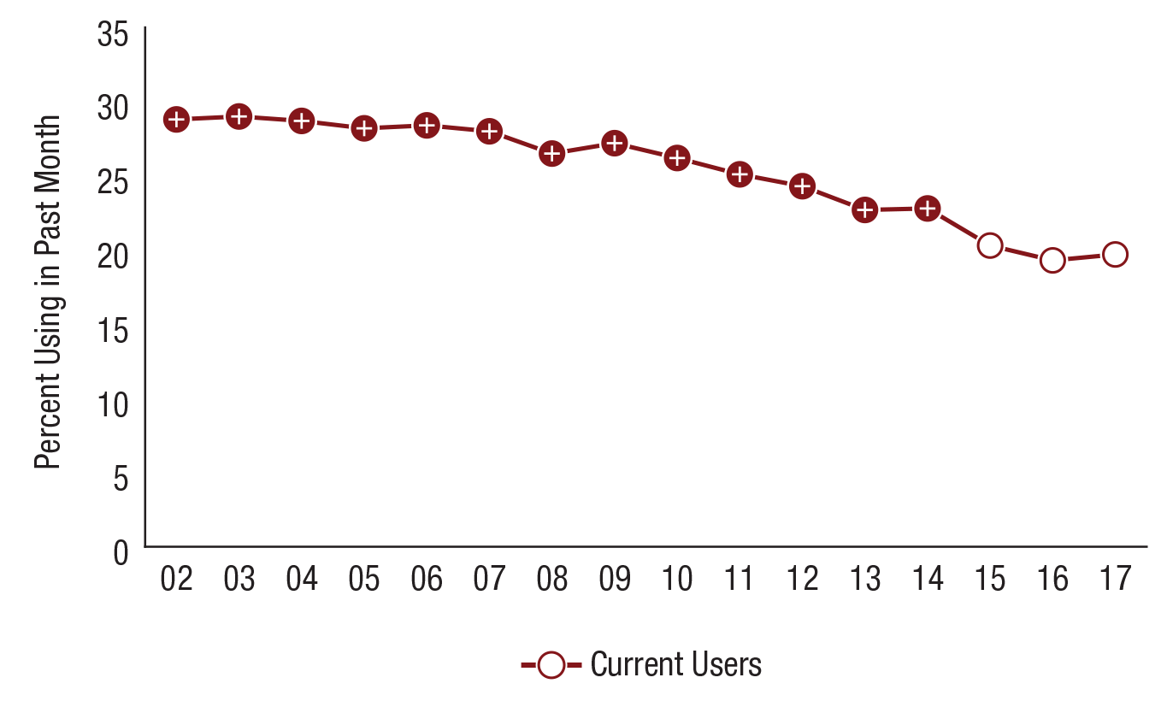
Current Alcohol Use among People Aged 12 to 20: Percentages, 2002-2017
FFR1.10
Use | 2002 | 2003 | 2004 | 2005 | 2006 | 2007 | 2008 | 2009 | 2010 | 2011 | 2012 | 2013 | 2014 | 2015 | 2016 | 2017
Current | 28.8⁺ | 29.0⁺ | 28.7⁺ | 28.2⁺ | 28.4⁺ | 28.0⁺ | 26.5⁺ | 27.2⁺ | 26.2⁺ | 25.1⁺ | 24.3⁺ | 22.7⁺ | 22.8⁺ | 20.3 | 19.3 | 19.7

Slide 6
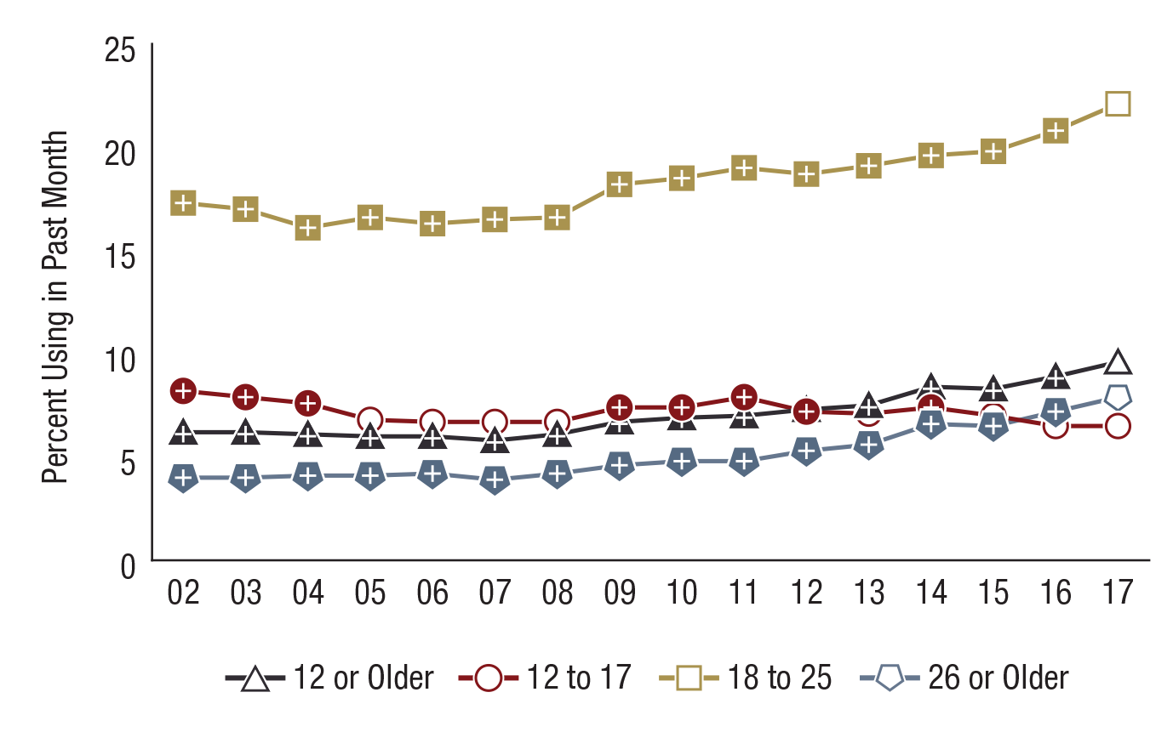
Past Month Marijuana Use among People Aged 12 or Older, by Age Group: Percentages, 2002-2017
FFR1.13
Age Group | 2002 | 2003 | 2004 | 2005 | 2006 | 2007 | 2008 | 2009 | 2010 | 2011 | 2012 | 2013 | 2014 | 2015 | 2016 | 2017
12 or Older | 6.2⁺ | 6.2⁺ | 6.1⁺ | 6.0⁺ | 6.0⁺ | 5.8⁺ | 6.1⁺ | 6.7⁺ | 6.9⁺ | 7.0⁺ | 7.3⁺ | 7.5⁺ | 8.4⁺ | 8.3⁺ | 8.9⁺ | 9.6
12 to 17 | 8.2⁺ | 7.9⁺ | 7.6⁺ | 6.8 | 6.7 | 6.7 | 6.7 | 7.4⁺ | 7.4⁺ | 7.9⁺ | 7.2⁺ | 7.1 | 7.4⁺ | 7.0 | 6.5 | 6.5
18 to 25 | 17.3⁺ | 17.0⁺ | 16.1⁺ | 16.6⁺ | 16.3⁺ | 16.5⁺ | 16.6⁺ | 18.2⁺ | 18.5⁺ | 19.0⁺ | 18.7⁺ | 19.1⁺ | 19.6⁺ | 19.8⁺ | 20.8⁺ | 22.1
26 or Older | 4.0⁺ | 4.0⁺ | 4.1⁺ | 4.1⁺ | 4.2⁺ | 3.9⁺ | 4.2⁺ | 4.6⁺ | 4.8⁺ | 4.8⁺ | 5.3⁺ | 5.6⁺ | 6.6⁺ | 6.5⁺ | 7.2⁺ | 7.9

Slide 7
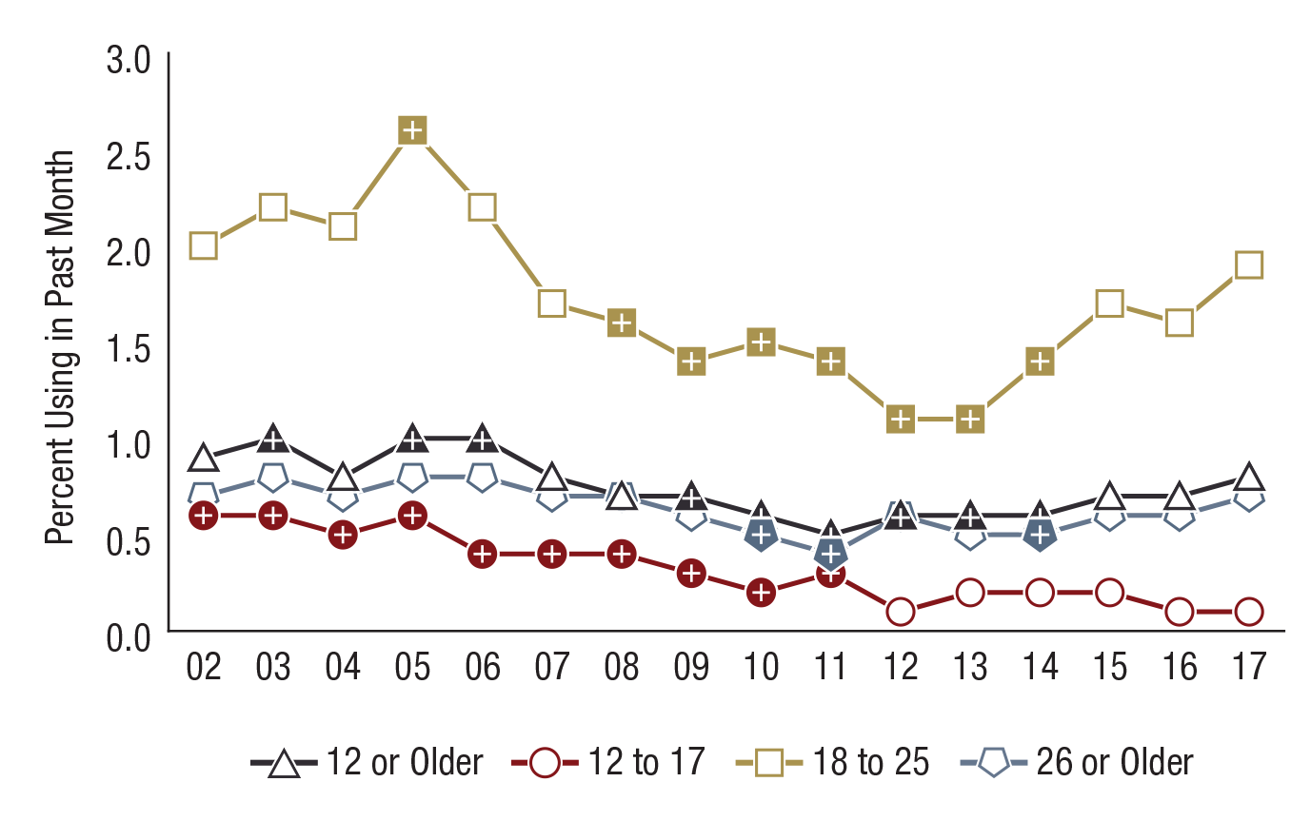
Past Month Cocaine Use among People Aged 12 or Older, by Age Group: Percentages, 2002-2017
FFR1.16
Age Group | 2002 | 2003 | 2004 | 2005 | 2006 | 2007 | 2008 | 2009 | 2010 | 2011 | 2012 | 2013 | 2014 | 2015 | 2016 | 2017
12 or Older | 0.9 | 1.0⁺ | 0.8 | 1.0⁺ | 1.0⁺ | 0.8 | 0.7 | 0.7⁺ | 0.6⁺ | 0.5⁺ | 0.6⁺ | 0.6⁺ | 0.6⁺ | 0.7 | 0.7 | 0.8
12 to 17 | 0.6⁺ | 0.6⁺ | 0.5⁺ | 0.6⁺ | 0.4⁺ | 0.4⁺ | 0.4⁺ | 0.3⁺ | 0.2⁺ | 0.3⁺ | 0.1 | 0.2 | 0.2 | 0.2 | 0.1 | 0.1
18 to 25 | 2.0 | 2.2 | 2.1 | 2.6⁺ | 2.2 | 1.7 | 1.6⁺ | 1.4⁺ | 1.5⁺ | 1.4⁺ | 1.1⁺ | 1.1⁺ | 1.4⁺ | 1.7 | 1.6 | 1.9
26 or Older | 0.7 | 0.8 | 0.7 | 0.8 | 0.8 | 0.7 | 0.7 | 0.6 | 0.5⁺ | 0.4⁺ | 0.6 | 0.5 | 0.5⁺ | 0.6 | 0.6 | 0.7

Slide 8
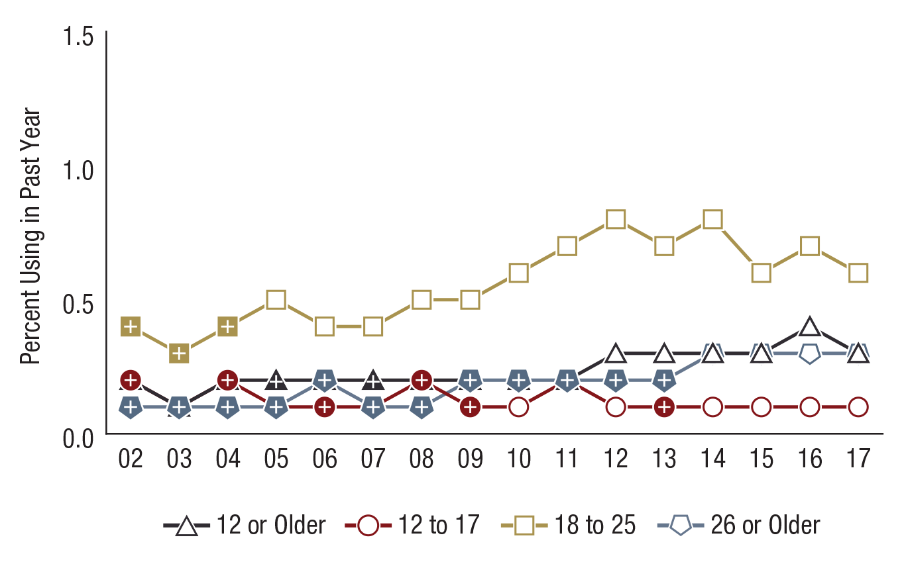
Past Year Heroin Use among People Aged 12 or Older, by Age Group: Percentages, 2002-2017
FFR1.22
Age Group | 2002 | 2003 | 2004 | 2005 | 2006 | 2007 | 2008 | 2009 | 2010 | 2011 | 2012 | 2013 | 2014 | 2015 | 2016 | 2017
12 or Older | 0.2⁺ | 0.1⁺ | 0.2⁺ | 0.2⁺ | 0.2⁺ | 0.2⁺ | 0.2⁺ | 0.2⁺ | 0.2 | 0.2⁺ | 0.3 | 0.3 | 0.3 | 0.3 | 0.4 | 0.3
12 to 17 | 0.2⁺ | 0.1⁺ | 0.2⁺ | 0.1⁺ | 0.1⁺ | 0.1 | 0.2⁺ | 0.1⁺ | 0.1 | 0.2⁺ | 0.1 | 0.1⁺ | 0.1 | 0.1 | 0.1 | 0.1
18 to 25 | 0.4⁺ | 0.3⁺ | 0.4⁺ | 0.5 | 0.4 | 0.4 | 0.5 | 0.5 | 0.6 | 0.7 | 0.8 | 0.7 | 0.8 | 0.6 | 0.7 | 0.6
26 or Older | 0.1⁺ | 0.1⁺ | 0.1⁺ | 0.1⁺ | 0.2⁺ | 0.1⁺ | 0.1⁺ | 0.2⁺ | 0.2⁺ | 0.2⁺ | 0.2⁺ | 0.2⁺ | 0.3 | 0.3 | 0.3 | 0.3

Slide 9
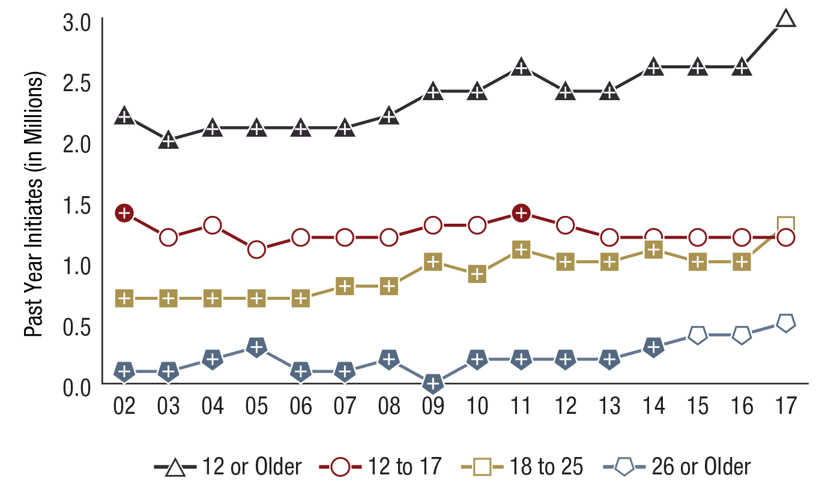
Past Year Marijuana Initiates among People Aged 12 or Older, by Age Group (in Millions): 2002-2017
FFR1.28
Note: Estimates of less than 0.1 million round to 0.0 million when shown to the nearest tenth of a million.
Age Group | 2002 | 2003 | 2004 | 2005 | 2006 | 2007 | 2008 | 2009 | 2010 | 2011 | 2012 | 2013 | 2014 | 2015 | 2016 | 2017
12 or Older | 2.2⁺ | 2.0⁺ | 2.1⁺ | 2.1⁺ | 2.1⁺ | 2.1⁺ | 2.2⁺ | 2.4⁺ | 2.4⁺ | 2.6⁺ | 2.4⁺ | 2.4⁺ | 2.6⁺ | 2.6⁺ | 2.6⁺ | 3.0
12 to 17 | 1.4⁺ | 1.2 | 1.3 | 1.1 | 1.2 | 1.2 | 1.2 | 1.3 | 1.3 | 1.4⁺ | 1.3 | 1.2 | 1.2 | 1.2 | 1.2 | 1.2
18 to 25 | 0.7⁺ | 0.7⁺ | 0.7⁺ | 0.7⁺ | 0.7⁺ | 0.8⁺ | 0.8⁺ | 1.0⁺ | 0.9⁺ | 1.1⁺ | 1.0⁺ | 1.0⁺ | 1.1⁺ | 1.0⁺ | 1.0⁺ | 1.3
26 or Older | 0.1⁺ | 0.1⁺ | 0.2⁺ | 0.3⁺ | 0.1⁺ | 0.1⁺ | 0.2⁺ | 0.0⁺ | 0.2⁺ | 0.2⁺ | 0.2⁺ | 0.2⁺ | 0.3⁺ | 0.4 | 0.4 | 0.5

Slide 10
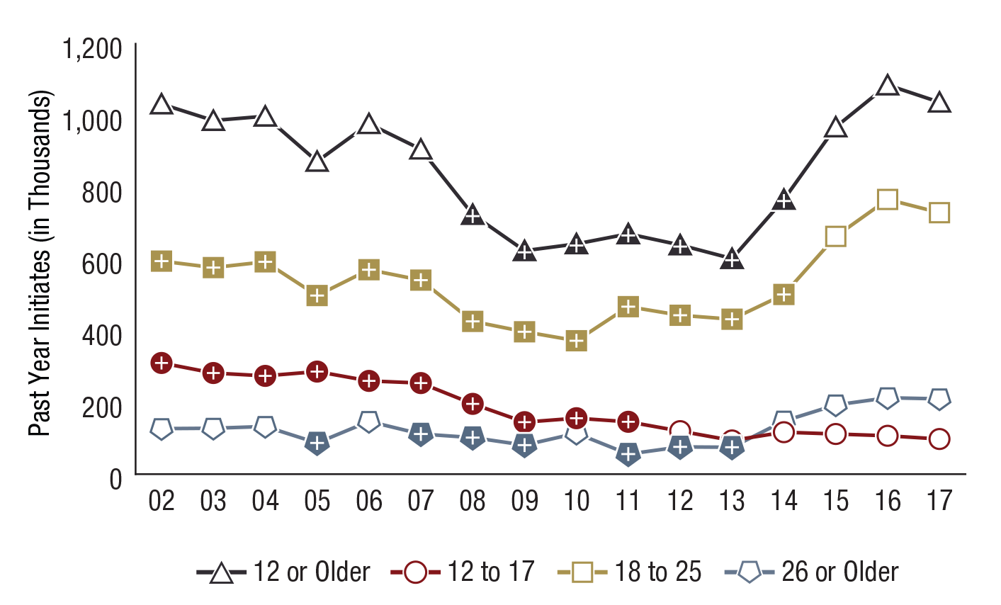
Past Year Cocaine Initiates among People Aged 12 or Older, by Age Group (in Thousands): 2002-2017
FFR1.29
Age Group | 2002 | 2003 | 2004 | 2005 | 2006 | 2007 | 2008 | 2009 | 2010 | 2011 | 2012 | 2013 | 2014 | 2015 | 2016 | 2017
12 or Older | 1,032 | 986 | 998 | 872 | 977 | 906 | 724⁺ | 623⁺ | 642⁺ | 670⁺ | 639⁺ | 601⁺ | 766⁺ | 968 | 1,085 | 1,037
12 to 17 | 310⁺ | 282⁺ | 274⁺ | 286⁺ | 260⁺ | 254⁺ | 196⁺ | 145⁺ | 156⁺ | 146⁺ | 120 | 94 | 117 | 112 | 107 | 98
18 to 25 | 594⁺ | 576⁺ | 592⁺ | 498⁺ | 570⁺ | 541⁺ | 426⁺ | 397⁺ | 372⁺ | 467⁺ | 443⁺ | 432⁺ | 501⁺ | 663 | 766 | 729
26 or Older | 127 | 128 | 133 | 87⁺ | 147 | 112⁺ | 102⁺ | 81⁺ | 114 | 56⁺ | 76⁺ | 75⁺ | 148 | 193 | 213 | 210

Slide 11
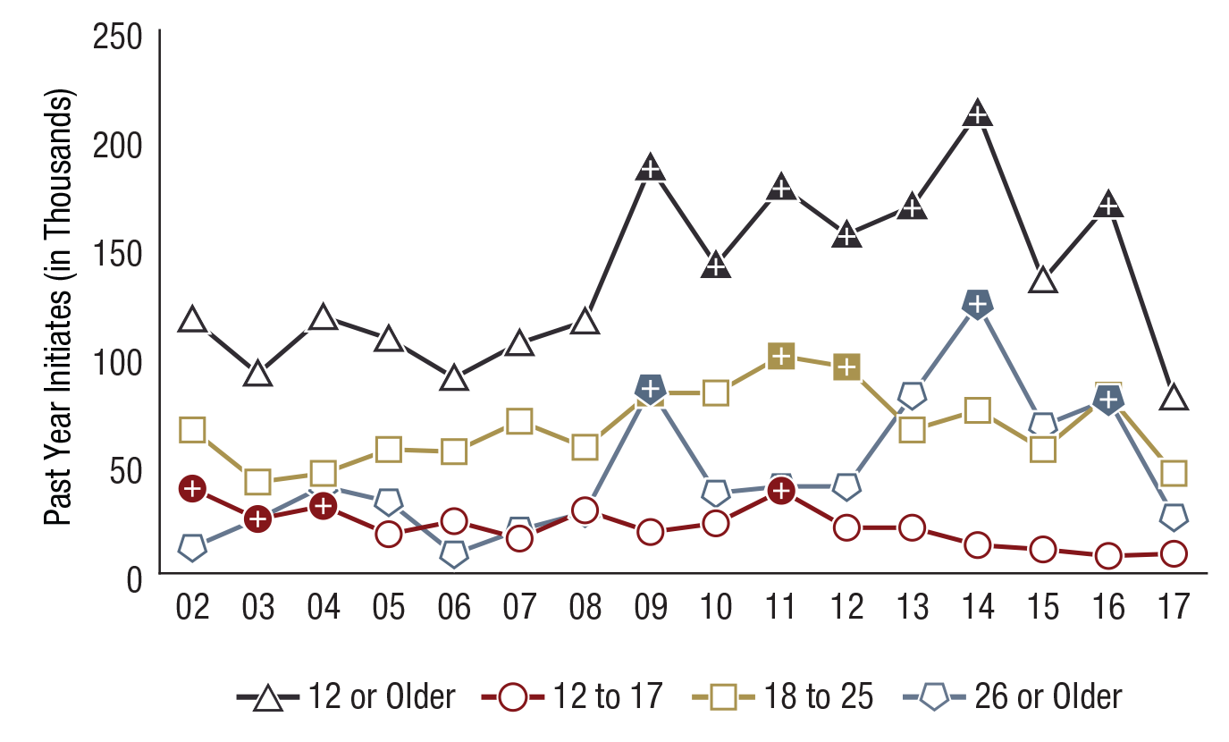
Past Year Heroin Initiates among People Aged 12 or Older, by Age Group (in Thousands): 2002-2017
FFR1.30
Age Group | 2002 | 2003 | 2004 | 2005 | 2006 | 2007 | 2008 | 2009 | 2010 | 2011 | 2012 | 2013 | 2014 | 2015 | 2016 | 2017
12 or Older | 117 | 92 | 118 | 108 | 90 | 106 | 116 | 187⁺ | 142⁺ | 178⁺ | 156⁺ | 169⁺ | 212⁺ | 135 | 170⁺ | 81
12 to 17 | 39⁺ | 25⁺ | 31⁺ | 18 | 24 | 16 | 29 | 19 | 23 | 38⁺ | 21 | 21 | 13 | 11 | 8 | 9
18 to 25 | 66 | 42 | 46 | 57 | 56 | 70 | 58 | 83⁺ | 83 | 100⁺ | 95⁺ | 66 | 75 | 57 | 82 | 46
26 or Older | 12 | 25 | 40 | 33 | 9 | 20 | 28 | 85⁺ | 37 | 40 | 40 | 82 | 124⁺ | 68 | 80⁺ | 26

Slide 12
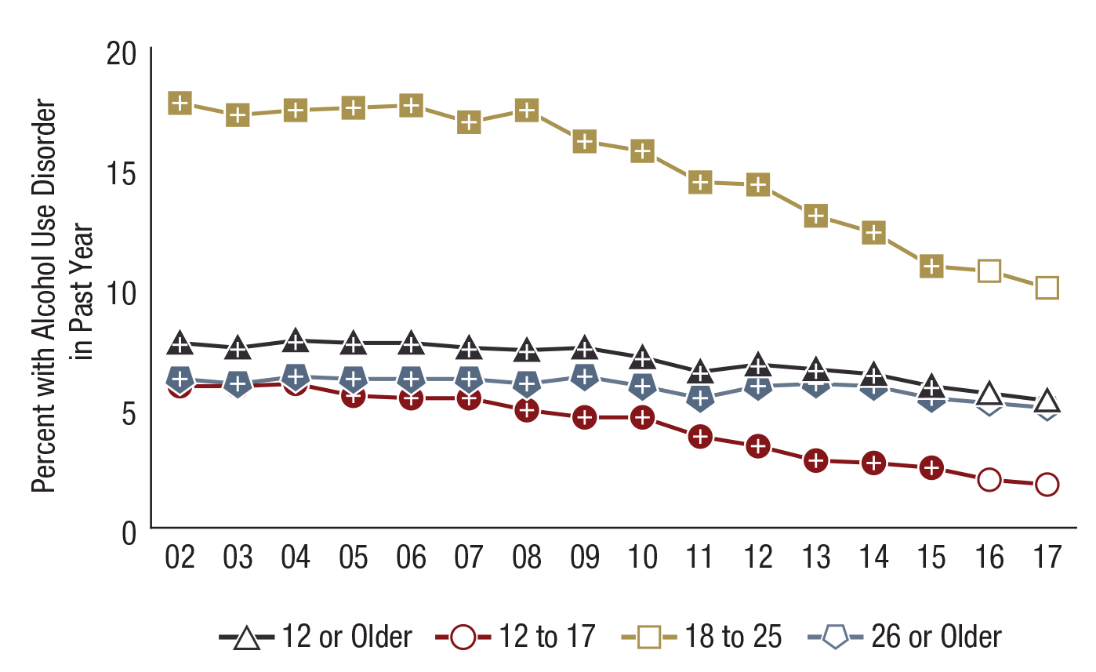
Alcohol Use Disorder in the Past Year among People Aged 12 or Older, by Age Group: Percentages, 2002-2017
FFR1.32
Age Group | 2002 | 2003 | 2004 | 2005 | 2006 | 2007 | 2008 | 2009 | 2010 | 2011 | 2012 | 2013 | 2014 | 2015 | 2016 | 2017
12 or Older | 7.7⁺ | 7.5⁺ | 7.8⁺ | 7.7⁺ | 7.7⁺ | 7.5⁺ | 7.4⁺ | 7.5⁺ | 7.1⁺ | 6.5⁺ | 6.8⁺ | 6.6⁺ | 6.4⁺ | 5.9⁺ | 5.6 | 5.3
12 to 17 | 5.9⁺ | 5.9⁺ | 6.0⁺ | 5.5⁺ | 5.4⁺ | 5.4⁺ | 4.9⁺ | 4.6⁺ | 4.6⁺ | 3.8⁺ | 3.4⁺ | 2.8⁺ | 2.7⁺ | 2.5⁺ | 2.0 | 1.8
18 to 25 | 17.7⁺ | 17.2⁺ | 17.4⁺ | 17.5⁺ | 17.6⁺ | 16.9⁺ | 17.4⁺ | 16.1⁺ | 15.7⁺ | 14.4⁺ | 14.3⁺ | 13.0⁺ | 12.3⁺ | 10.9⁺ | 10.7 | 10.0
26 or Older | 6.2⁺ | 6.0⁺ | 6.3⁺ | 6.2⁺ | 6.2⁺ | 6.2⁺ | 6.0⁺ | 6.3⁺ | 5.9⁺ | 5.4⁺ | 5.9⁺ | 6.0⁺ | 5.9⁺ | 5.4⁺ | 5.2 | 5.0

Slide 13
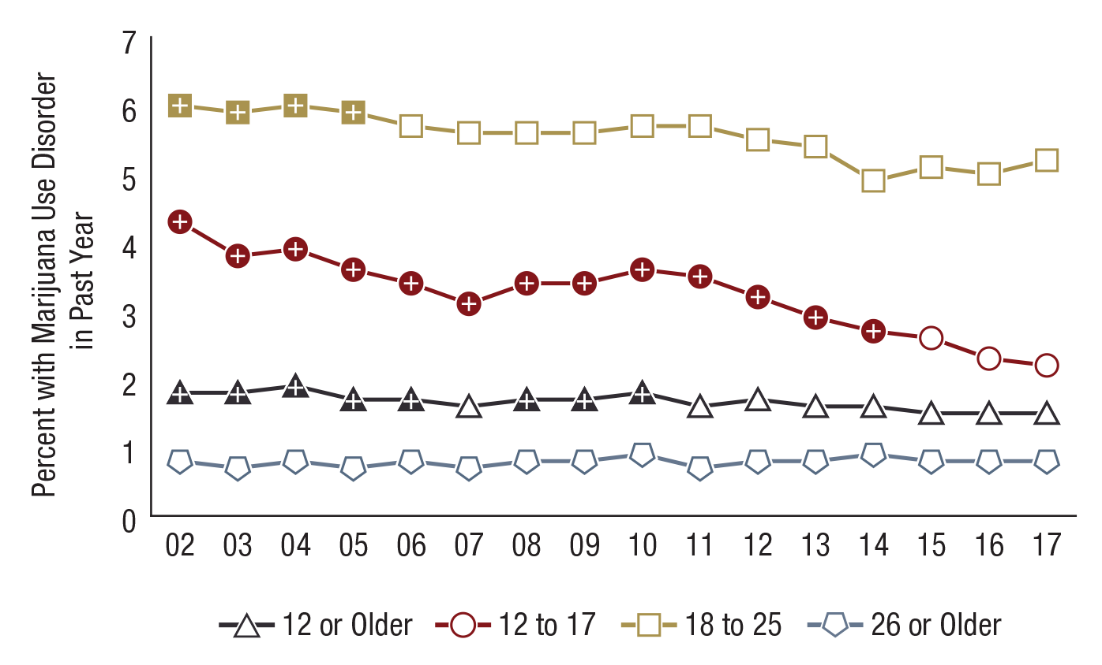
Marijuana Use Disorder in the Past Year among People Aged 12 or Older, by Age Group: Percentages, 2002-2017
FFR1.34
Age Group | 2002 | 2003 | 2004 | 2005 | 2006 | 2007 | 2008 | 2009 | 2010 | 2011 | 2012 | 2013 | 2014 | 2015 | 2016 | 2017
12 or Older | 1.8⁺ | 1.8⁺ | 1.9⁺ | 1.7⁺ | 1.7⁺ | 1.6 | 1.7⁺ | 1.7⁺ | 1.8⁺ | 1.6 | 1.7 | 1.6 | 1.6 | 1.5 | 1.5 | 1.5
12 to 17 | 4.3⁺ | 3.8⁺ | 3.9⁺ | 3.6⁺ | 3.4⁺ | 3.1⁺ | 3.4⁺ | 3.4⁺ | 3.6⁺ | 3.5⁺ | 3.2⁺ | 2.9⁺ | 2.7⁺ | 2.6 | 2.3 | 2.2
18 to 25 | 6.0⁺ | 5.9⁺ | 6.0⁺ | 5.9⁺ | 5.7 | 5.6 | 5.6 | 5.6 | 5.7 | 5.7 | 5.5 | 5.4 | 4.9 | 5.1 | 5.0 | 5.2
26 or Older | 0.8 | 0.7 | 0.8 | 0.7 | 0.8 | 0.7 | 0.8 | 0.8 | 0.9 | 0.7 | 0.8 | 0.8 | 0.9 | 0.8 | 0.8 | 0.8

Slide 14
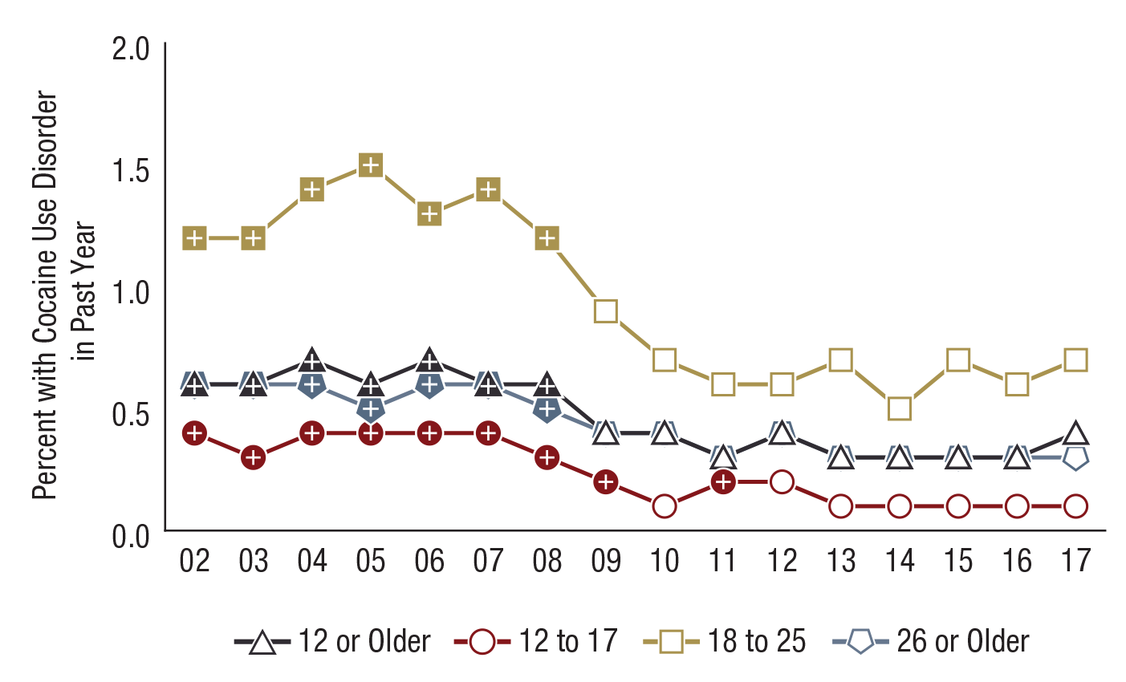
Cocaine Use Disorder in the Past Year among People Aged 12 or Older, by Age Group: Percentages, 2002-2017
FFR1.36
Age Group | 2002 | 2003 | 2004 | 2005 | 2006 | 2007 | 2008 | 2009 | 2010 | 2011 | 2012 | 2013 | 2014 | 2015 | 2016 | 2017
12 or Older | 0.6⁺ | 0.6⁺ | 0.7⁺ | 0.6⁺ | 0.7⁺ | 0.6⁺ | 0.6⁺ | 0.4 | 0.4 | 0.3 | 0.4 | 0.3 | 0.3 | 0.3 | 0.3 | 0.4
12 to 17 | 0.4⁺ | 0.3⁺ | 0.4⁺ | 0.4⁺ | 0.4⁺ | 0.4⁺ | 0.3⁺ | 0.2⁺ | 0.1 | 0.2⁺ | 0.2 | 0.1 | 0.1 | 0.1 | 0.1 | 0.1
18 to 25 | 1.2⁺ | 1.2⁺ | 1.4⁺ | 1.5⁺ | 1.3⁺ | 1.4⁺ | 1.2⁺ | 0.9 | 0.7 | 0.6 | 0.6 | 0.7 | 0.5 | 0.7 | 0.6 | 0.7
26 or Older | 0.6⁺ | 0.6⁺ | 0.6⁺ | 0.5⁺ | 0.6⁺ | 0.6⁺ | 0.5⁺ | 0.4 | 0.4 | 0.3 | 0.4 | 0.3 | 0.3 | 0.3 | 0.3 | 0.3

Slide 15
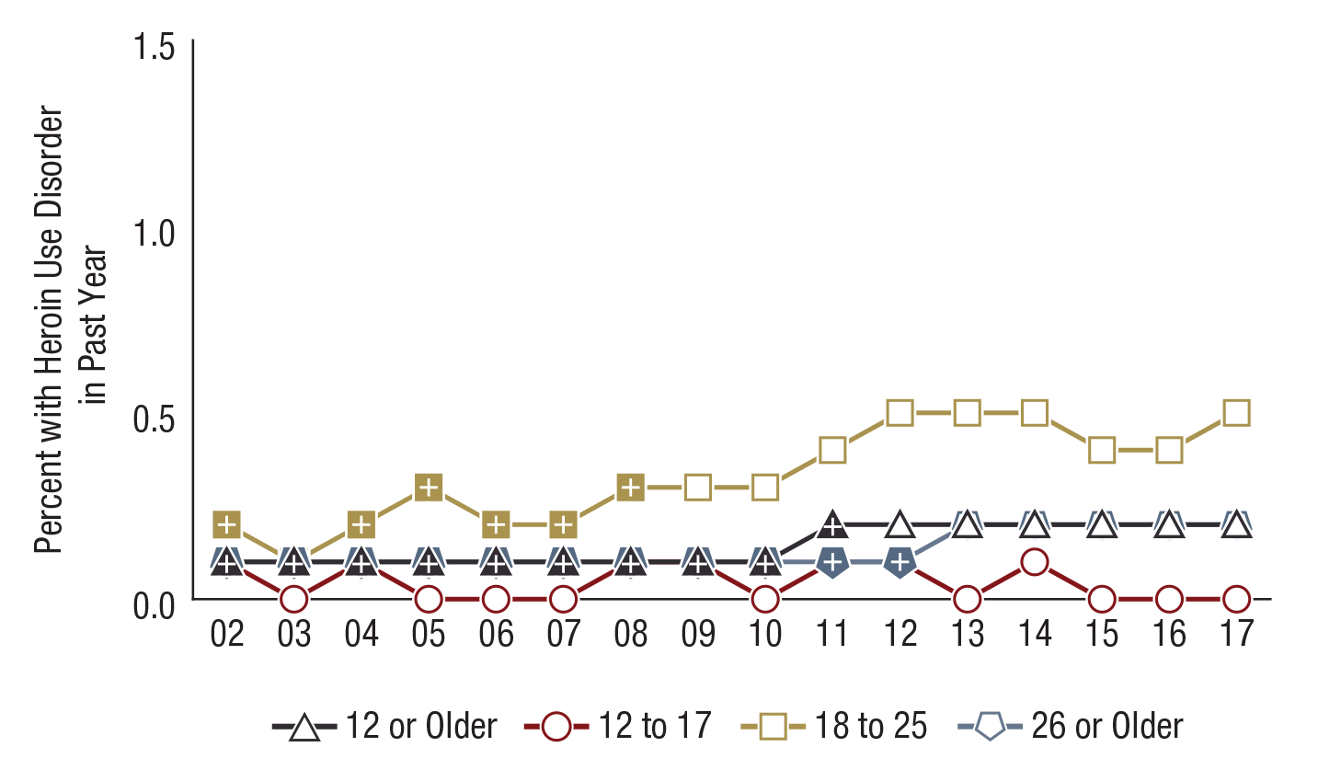
Heroin Use Disorder in the Past Year among People Aged 12 or Older, by Age Group: Percentages, 2002-2017
FFR1.37
Note: Estimates of less than 0.1 percent round to 0.0 percent when shown to the nearest tenth of a percent.
Age Group | 2002 | 2003 | 2004 | 2005 | 2006 | 2007 | 2008 | 2009 | 2010 | 2011 | 2012 | 2013 | 2014 | 2015 | 2016 | 2017
12 or Older | 0.1⁺ | 0.1⁺ | 0.1⁺ | 0.1⁺ | 0.1⁺ | 0.1⁺ | 0.1⁺ | 0.1⁺ | 0.1⁺ | 0.2⁺ | 0.2 | 0.2 | 0.2 | 0.2 | 0.2 | 0.2
12 to 17 | 0.1 | 0.0 | 0.1⁺ | 0.0 | 0.0 | 0.0 | 0.1⁺ | 0.1⁺ | 0.0 | 0.1⁺ | 0.1 | 0.0 | 0.1 | 0.0 | 0.0 | 0.0
18 to 25 | 0.2⁺ | 0.1⁺ | 0.2⁺ | 0.3⁺ | 0.2⁺ | 0.2⁺ | 0.3⁺ | 0.3 | 0.3 | 0.4 | 0.5 | 0.5 | 0.5 | 0.4 | 0.4 | 0.5
26 or Older | 0.1⁺ | 0.1⁺ | 0.1⁺ | 0.1⁺ | 0.1⁺ | 0.1⁺ | 0.1⁺ | 0.1⁺ | 0.1⁺ | 0.1⁺ | 0.1⁺ | 0.2 | 0.2 | 0.2 | 0.2 | 0.2

Slide 16
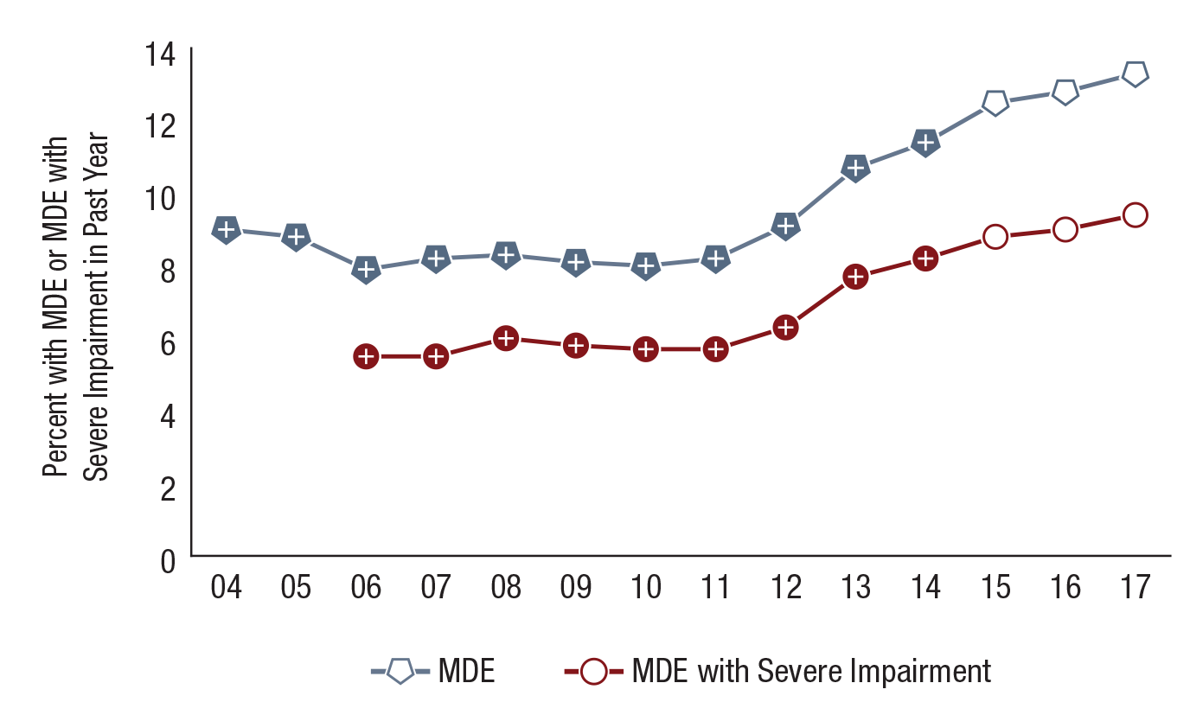
Major Depressive Episode (MDE) and MDE with Severe Impairment in the Past Year among Youths Aged 12 to 17: Percentages, 2004-2017
FFR1.43
N/A = not available.
MDE Status | 2004 | 2005 | 2006 | 2007 | 2008 | 2009 | 2010 | 2011 | 2012 | 2013 | 2014 | 2015 | 2016 | 2017
MDE | 9.0⁺ | 8.8⁺ | 7.9⁺ | 8.2⁺ | 8.3⁺ | 8.1⁺ | 8.0⁺ | 8.2⁺ | 9.1⁺ | 10.7⁺ | 11.4⁺ | 12.5 | 12.8 | 13.3
MDE with Severe Impairment | N/A | N/A | 5.5⁺ | 5.5⁺ | 6.0⁺ | 5.8⁺ | 5.7⁺ | 5.7⁺ | 6.3⁺ | 7.7⁺ | 8.2⁺ | 8.8 | 9.0 | 9.4

Slide 17
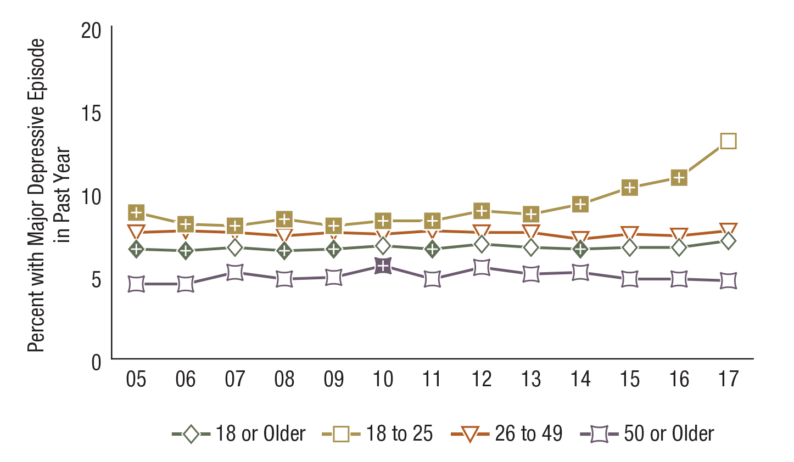
Major Depressive Episode in the Past Year among Adults Aged 18 or Older, by Age Group: Percentages, 2005-2017
FFR1.45
Age Group | 2005 | 2006 | 2007 | 2008 | 2009 | 2010 | 2011 | 2012 | 2013 | 2014 | 2015 | 2016 | 2017
18 or Older | 6.6⁺ | 6.5⁺ | 6.7 | 6.5⁺ | 6.6⁺ | 6.8 | 6.6⁺ | 6.9 | 6.7 | 6.6⁺ | 6.7 | 6.7 | 7.1
18 to 25 | 8.8⁺ | 8.1⁺ | 8.0⁺ | 8.4⁺ | 8.0⁺ | 8.3⁺ | 8.3⁺ | 8.9⁺ | 8.7⁺ | 9.3⁺ | 10.3⁺ | 10.9⁺ | 13.1
26 to 49 | 7.6 | 7.7 | 7.6 | 7.4 | 7.6 | 7.5 | 7.7 | 7.6 | 7.6 | 7.2 | 7.5 | 7.4 | 7.7
50 or Older | 4.5 | 4.5 | 5.2 | 4.8 | 4.9 | 5.6⁺ | 4.8 | 5.5 | 5.1 | 5.2 | 4.8 | 4.8 | 4.7

Slide 18
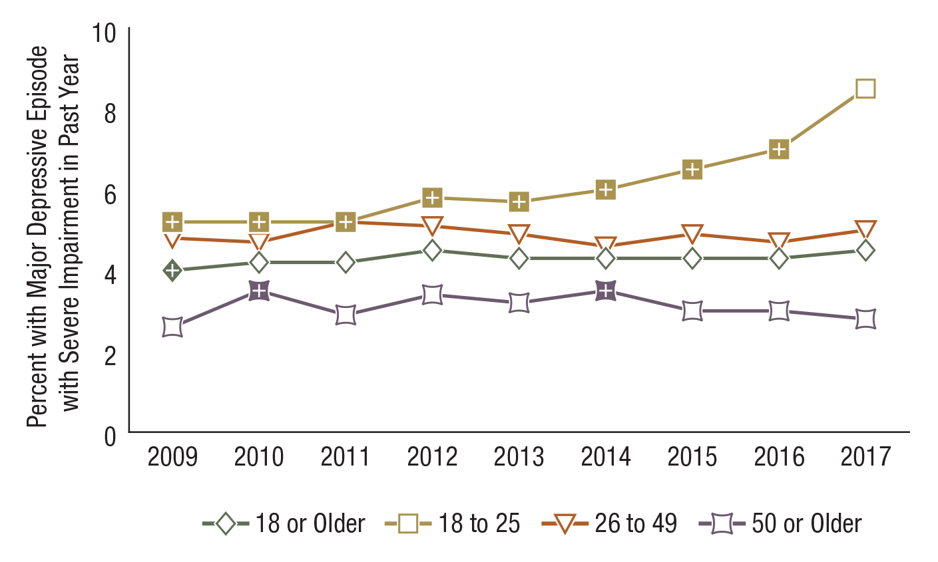
Major Depressive Episode with Severe Impairment in the Past Year among Adults Aged 18 or Older, by Age Group: Percentages, 2009-2017
FFR1.46
Age Group | 2009 | 2010 | 2011 | 2012 | 2013 | 2014 | 2015 | 2016 | 2017
18 or Older | 4.0⁺ | 4.2 | 4.2 | 4.5 | 4.3 | 4.3 | 4.3 | 4.3 | 4.5
18 to 25 | 5.2⁺ | 5.2⁺ | 5.2⁺ | 5.8⁺ | 5.7⁺ | 6.0⁺ | 6.5⁺ | 7.0⁺ | 8.5
26 to 49 | 4.8 | 4.7 | 5.2 | 5.1 | 4.9 | 4.6 | 4.9 | 4.7 | 5.0
50 or Older | 2.6 | 3.5⁺ | 2.9 | 3.4 | 3.2 | 3.5⁺ | 3.0 | 3.0 | 2.8

Slide 19
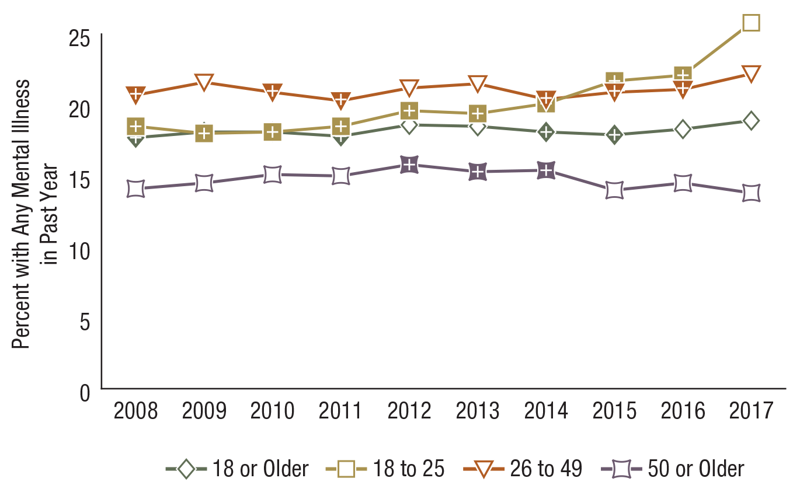
Any Mental Illness in the Past Year among Adults Aged 18 or Older, by Age Group: Percentages, 2008-2017
FFR1.48
Age Group | 2008 | 2009 | 2010 | 2011 | 2012 | 2013 | 2014 | 2015 | 2016 | 2017
18 or Older | 17.7⁺ | 18.1 | 18.1⁺ | 17.8⁺ | 18.6 | 18.5 | 18.1⁺ | 17.9⁺ | 18.3 | 18.9
18 to 25 | 18.5⁺ | 18.0⁺ | 18.1⁺ | 18.5⁺ | 19.6⁺ | 19.4⁺ | 20.1⁺ | 21.7⁺ | 22.1⁺ | 25.8
26 to 49 | 20.7⁺ | 21.6 | 20.9⁺ | 20.3⁺ | 21.2 | 21.5 | 20.4⁺ | 20.9⁺ | 21.1⁺ | 22.2
50 or Older | 14.1 | 14.5 | 15.1 | 15.0 | 15.8⁺ | 15.3⁺ | 15.4⁺ | 14.0 | 14.5 | 13.8

Slide 20
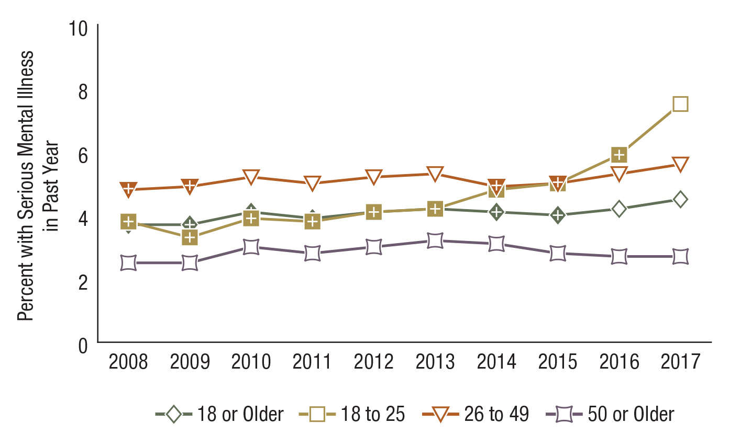
Serious Mental Illness in the Past Year among Adults Aged 18 or Older, by Age Group: Percentages, 2008-2017
FFR1.49
Age Group | 2008 | 2009 | 2010 | 2011 | 2012 | 2013 | 2014 | 2015 | 2016 | 2017
18 or Older | 3.7⁺ | 3.7⁺ | 4.1⁺ | 3.9⁺ | 4.1⁺ | 4.2 | 4.1⁺ | 4.0⁺ | 4.2 | 4.5
18 to 25 | 3.8⁺ | 3.3⁺ | 3.9⁺ | 3.8⁺ | 4.1⁺ | 4.2⁺ | 4.8⁺ | 5.0⁺ | 5.9⁺ | 7.5
26 to 49 | 4.8⁺ | 4.9⁺ | 5.2 | 5.0 | 5.2 | 5.3 | 4.9⁺ | 5.0⁺ | 5.3 | 5.6
50 or Older | 2.5 | 2.5 | 3.0 | 2.8 | 3.0 | 3.2 | 3.1 | 2.8 | 2.7 | 2.7

Slide 21
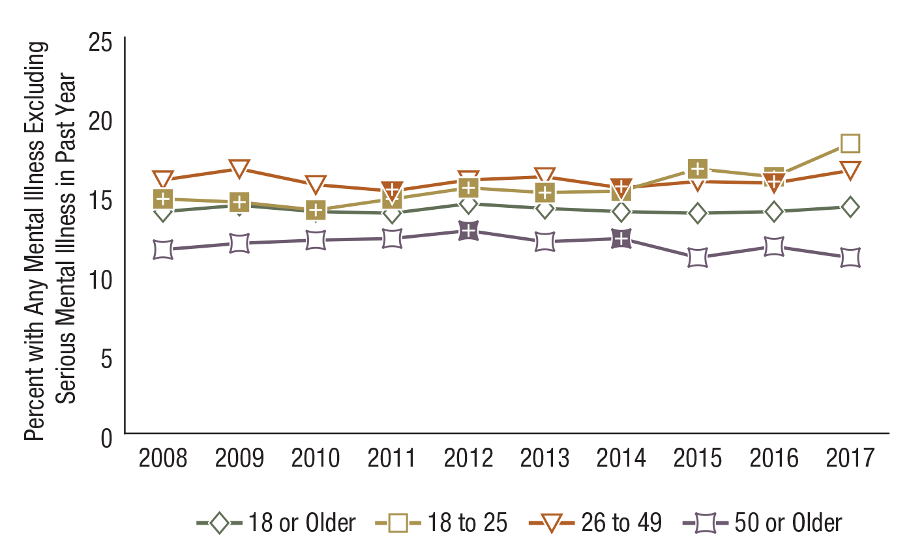
Any Mental Illness Excluding Serious Mental Illness in the Past Year among Adults Aged 18 or Older, by Age Group: Percentages, 2008-2017
FFR1.50
Age Group | 2008 | 2009 | 2010 | 2011 | 2012 | 2013 | 2014 | 2015 | 2016 | 2017
18 or Older | 14.0 | 14.4 | 14.0 | 13.9 | 14.5 | 14.2 | 14.0 | 13.9 | 14.0 | 14.3
18 to 25 | 14.8⁺ | 14.6⁺ | 14.1⁺ | 14.8⁺ | 15.5⁺ | 15.2⁺ | 15.3⁺ | 16.7⁺ | 16.2⁺ | 18.3
26 to 49 | 16.0 | 16.7 | 15.7 | 15.3⁺ | 16.0 | 16.2 | 15.5⁺ | 15.9 | 15.8⁺ | 16.6
50 or Older | 11.6 | 12.0 | 12.2 | 12.3 | 12.8⁺ | 12.1 | 12.3⁺ | 11.1 | 11.8 | 11.1

Slide 22
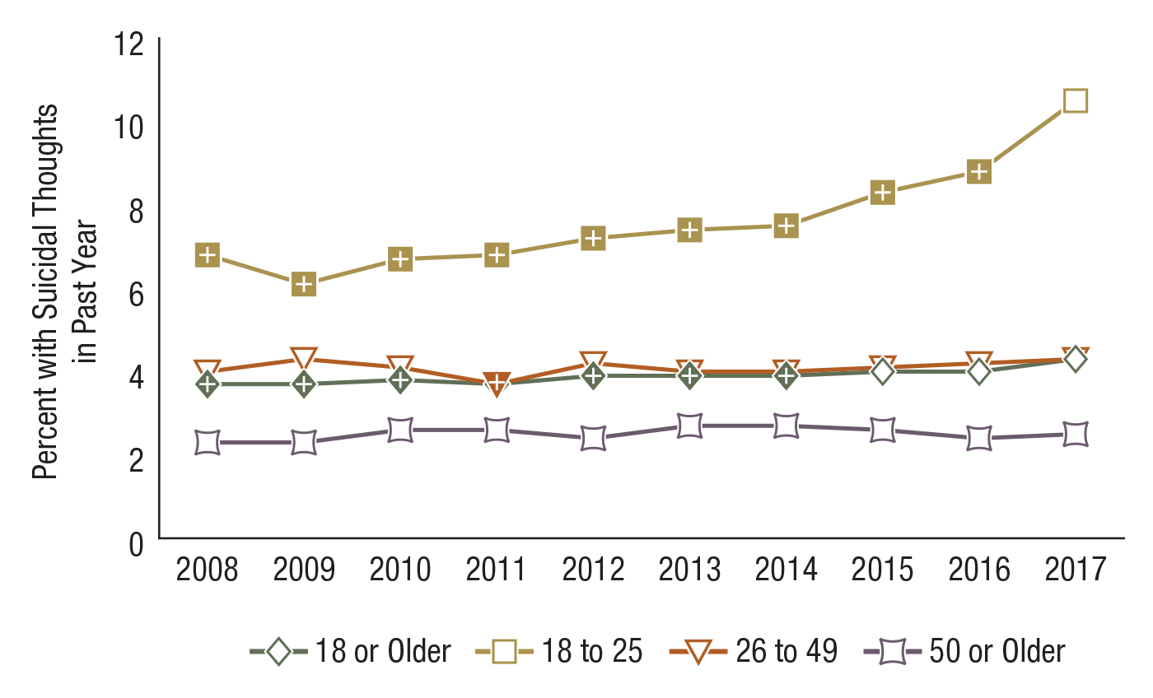
Suicidal Thoughts in the Past Year among Adults Aged 18 or Older, by Age Group: Percentages, 2008-2017
FFR1.59
Age Group | 2008 | 2009 | 2010 | 2011 | 2012 | 2013 | 2014 | 2015 | 2016 | 2017
18 or Older | 3.7⁺ | 3.7⁺ | 3.8⁺ | 3.7⁺ | 3.9⁺ | 3.9⁺ | 3.9⁺ | 4.0 | 4.0 | 4.3
18 to 25 | 6.8⁺ | 6.1⁺ | 6.7⁺ | 6.8⁺ | 7.2⁺ | 7.4⁺ | 7.5⁺ | 8.3⁺ | 8.8⁺ | 10.5
26 to 49 | 4.0 | 4.3 | 4.1 | 3.7⁺ | 4.2 | 4.0 | 4.0 | 4.1 | 4.2 | 4.3
50 or Older | 2.3 | 2.3 | 2.6 | 2.6 | 2.4 | 2.7 | 2.7 | 2.6 | 2.4 | 2.5

Slide 23
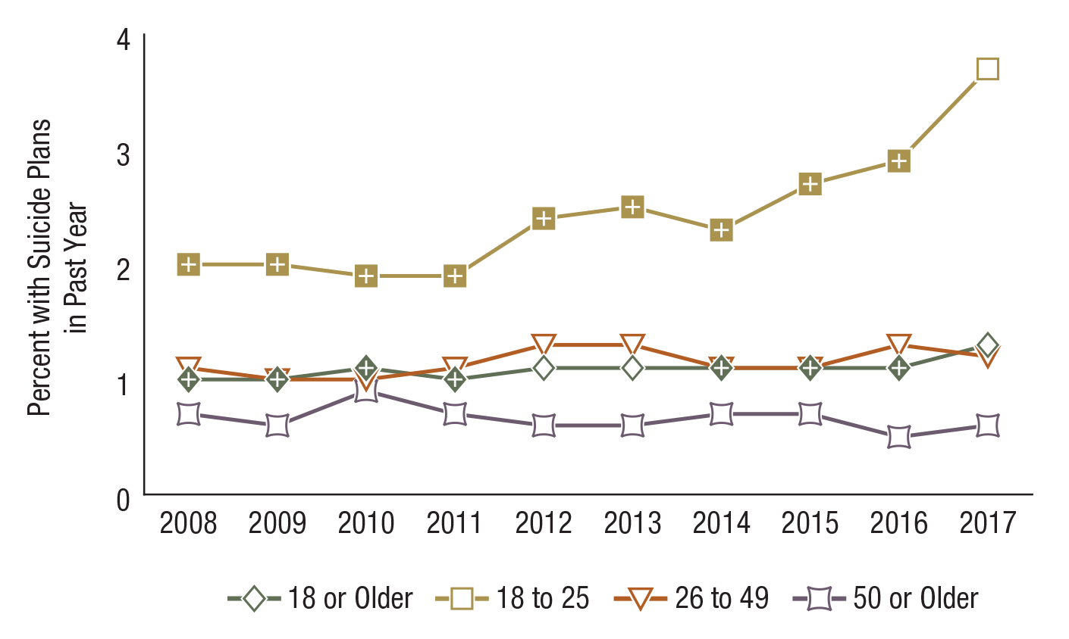
Suicide Plans in the Past Year among Adults Aged 18 or Older, by Age Group: Percentages, 2008-2017
FFR1.60
Age Group | 2008 | 2009 | 2010 | 2011 | 2012 | 2013 | 2014 | 2015 | 2016 | 2017
18 or Older | 1.0⁺ | 1.0⁺ | 1.1⁺ | 1.0⁺ | 1.1 | 1.1 | 1.1⁺ | 1.1⁺ | 1.1⁺ | 1.3
18 to 25 | 2.0⁺ | 2.0⁺ | 1.9⁺ | 1.9⁺ | 2.4⁺ | 2.5⁺ | 2.3⁺ | 2.7⁺ | 2.9⁺ | 3.7
26 to 49 | 1.1 | 1.0 | 1.0 | 1.1 | 1.3 | 1.3 | 1.1 | 1.1 | 1.3 | 1.2
50 or Older | 0.7 | 0.6 | 0.9 | 0.7 | 0.6 | 0.6 | 0.7 | 0.7 | 0.5 | 0.6

Slide 24
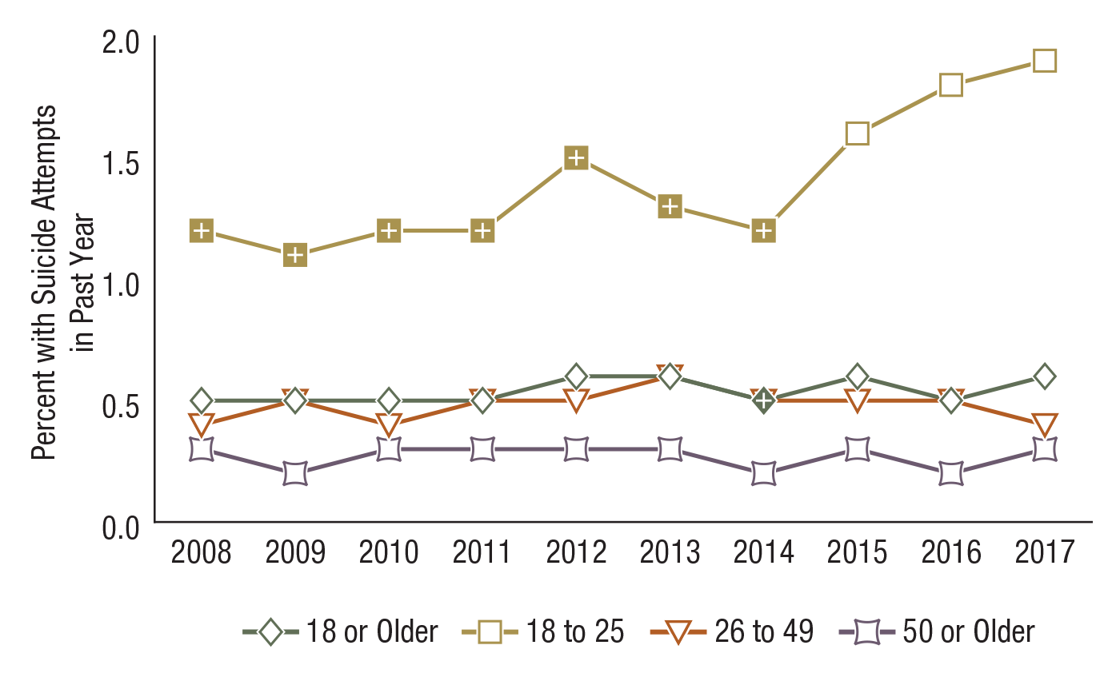
Suicide Attempts in the Past Year among Adults Aged 18 or Older, by Age Group: Percentages, 2008-2017
FFR1.61
Age Group | 2008 | 2009 | 2010 | 2011 | 2012 | 2013 | 2014 | 2015 | 2016 | 2017
18 or Older | 0.5 | 0.5 | 0.5 | 0.5 | 0.6 | 0.6 | 0.5⁺ | 0.6 | 0.5 | 0.6
18 to 25 | 1.2⁺ | 1.1⁺ | 1.2⁺ | 1.2⁺ | 1.5⁺ | 1.3⁺ | 1.2⁺ | 1.6 | 1.8 | 1.9
26 to 49 | 0.4 | 0.5 | 0.4 | 0.5 | 0.5 | 0.6 | 0.5 | 0.5 | 0.5 | 0.4
50 or Older | 0.3 | 0.2 | 0.3 | 0.3 | 0.3 | 0.3 | 0.3 | 0.3 | 0.2 | 0.3

Slide 25
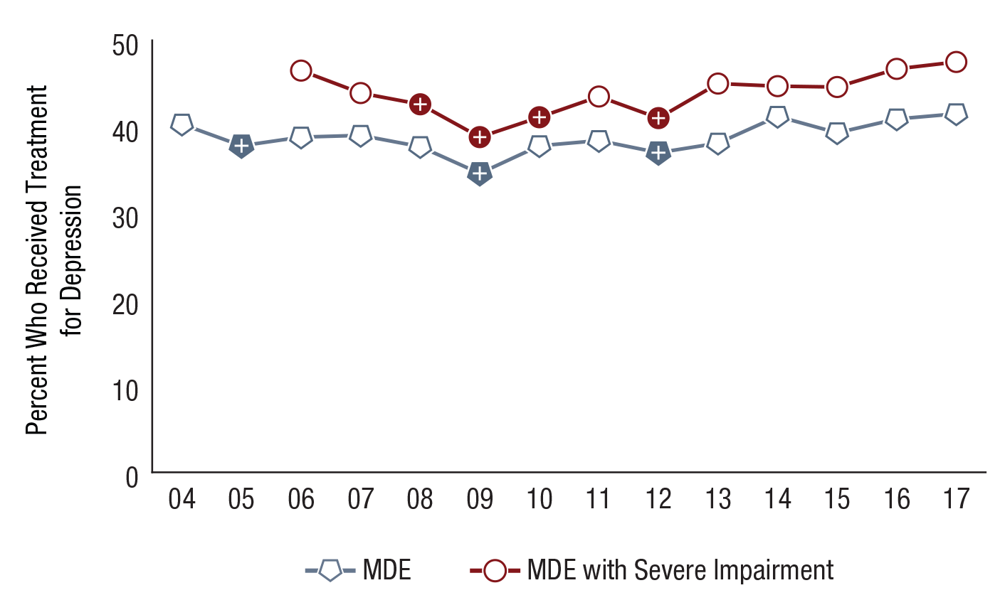
Received Treatment in the Past Year for Depression among Youths Aged 12 to 17 with a Past Year Major Depressive Episode (MDE) or MDE with Severe Impairment: Percentages, 2004-2017
FFR1.68
N/A = not available.
MDE Status | 2004 | 2005 | 2006 | 2007 | 2008 | 2009 | 2010 | 2011 | 2012 | 2013 | 2014 | 2015 | 2016 | 2017
MDE | 40.3 | 37.8⁺ | 38.8 | 39.0 | 37.7 | 34.6⁺ | 37.8 | 38.4 | 37.0⁺ | 38.1 | 41.2 | 39.3 | 40.9 | 41.5
MDE with Severe Impairment | N/A | N/A | 46.5 | 43.9 | 42.6⁺ | 38.8⁺ | 41.1⁺ | 43.5 | 41.0⁺ | 45.0 | 44.7 | 44.6 | 46.7 | 47.5

Slide 26
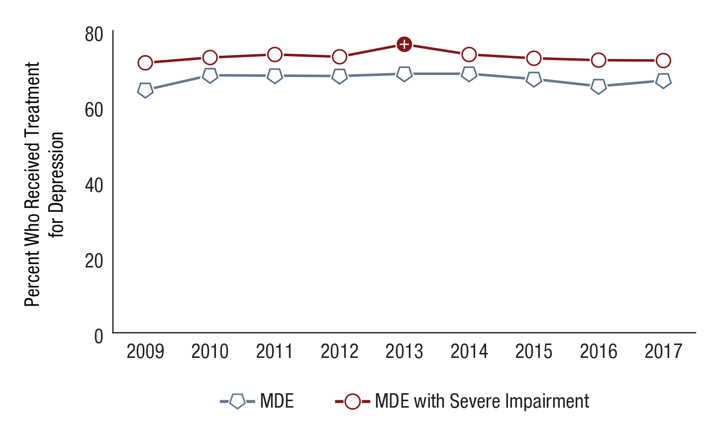
Received Treatment in the Past Year for Depression among Adults Aged 18 or Older with a Past Year Major Depressive Episode (MDE) or MDE with Severe Impairment: Percentages, 2009-2017
FFR1.69
MDE Status | 2009 | 2010 | 2011 | 2012 | 2013 | 2014 | 2015 | 2016 | 2017
MDE | 64.3 | 68.2 | 68.1 | 68.0 | 68.6 | 68.6 | 67.2 | 65.3 | 66.8
MDE with Severe Impairment | 71.5 | 72.9 | 73.7 | 73.1 | 76.4⁺ | 73.7 | 72.7 | 72.2 | 72.1

Slide 27
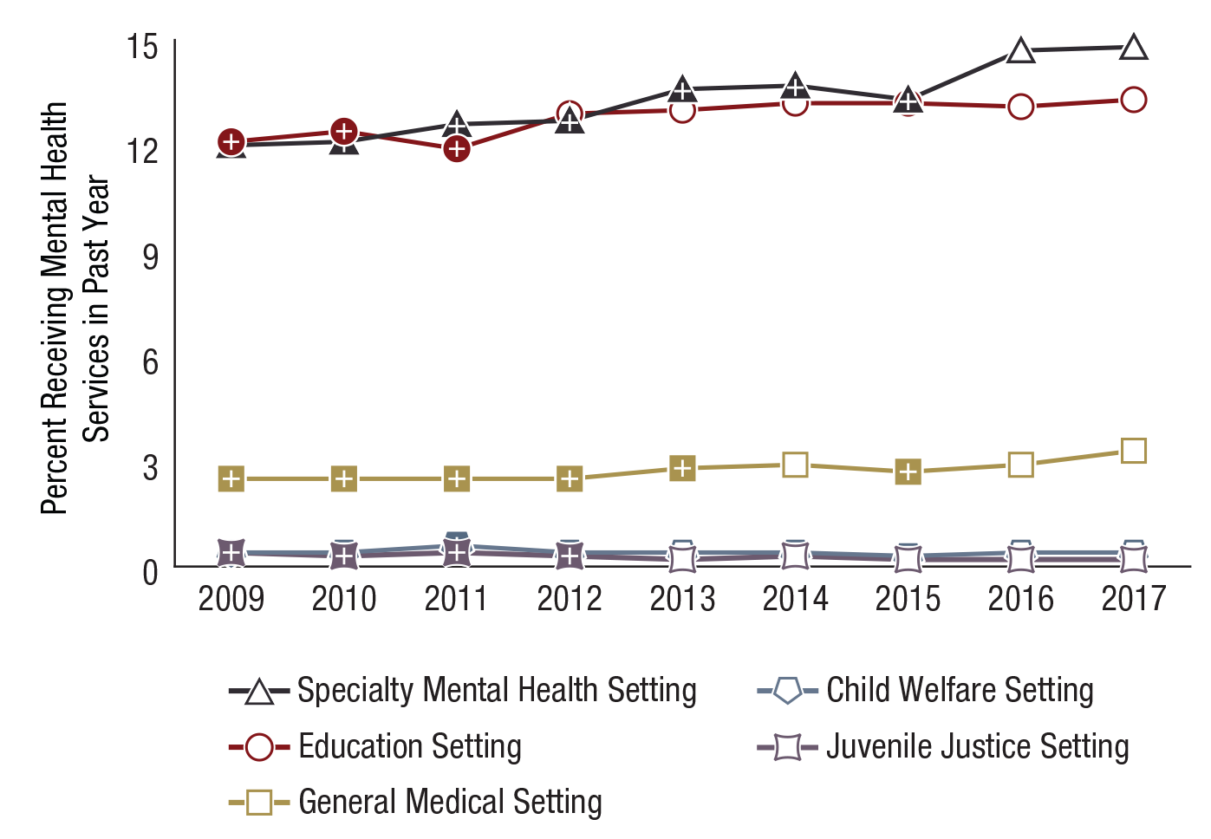
Sources of Mental Health Services in the Past Year among Youths Aged 12 to 17: Percentages, 2009-2017
FFR1.71
Note: Mental health service for youths aged 12 to 17 is defined as having received treatment/counseling for emotional or behavioral problems not caused by substance use.
Source | 2009 | 2010 | 2011 | 2012 | 2013 | 2014 | 2015 | 2016 | 2017
Specialty Mental Health Setting | 12.0⁺ | 12.1⁺ | 12.6⁺ | 12.7⁺ | 13.6⁺ | 13.7⁺ | 13.3⁺ | 14.7 | 14.8
Education Settings | 12.1⁺ | 12.4⁺ | 11.9⁺ | 12.9 | 13.0 | 13.2 | 13.2 | 13.1 | 13.3
General Medical Setting | 2.5⁺ | 2.5⁺ | 2.5⁺ | 2.5⁺ | 2.8⁺ | 2.9 | 2.7⁺ | 2.9 | 3.3
Child Welfare Setting | 0.4 | 0.4 | 0.6⁺ | 0.4 | 0.4 | 0.4 | 0.3 | 0.4 | 0.4
Juvenile Justice Setting | 0.4⁺ | 0.3⁺ | 0.4⁺ | 0.3⁺ | 0.2 | 0.3 | 0.2 | 0.2 | 0.2

Slide 28
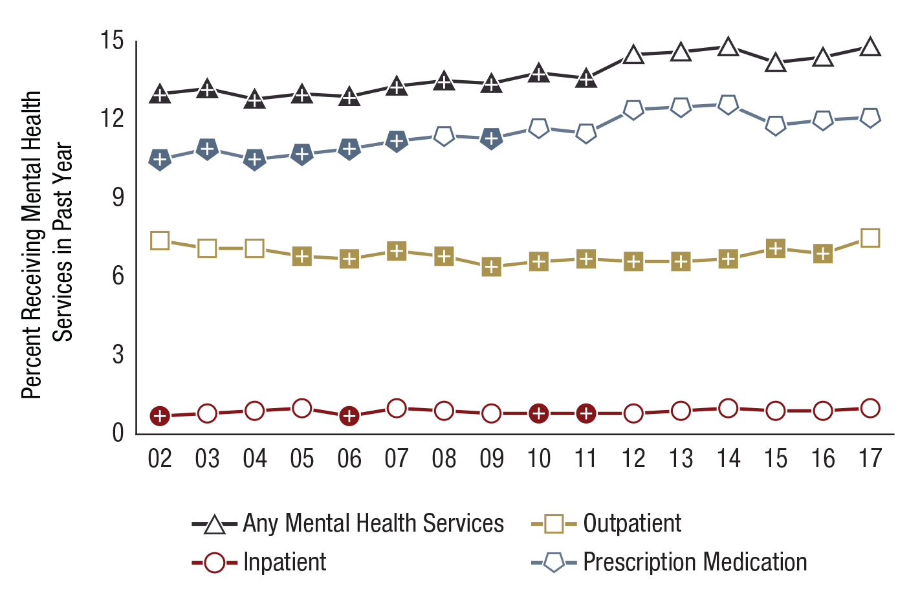
Type of Mental Health Services Received in the Past Year among Adults Aged 18 or Older: Percentages, 2002-2017
FFR1.72
Note: Mental health service is defined as having received inpatient care or outpatient care or having used prescription medication for problems with emotions, nerves, or mental health.
Service Type | 2002 | 2003 | 2004 | 2005 | 2006 | 2007 | 2008 | 2009 | 2010 | 2011 | 2012 | 2013 | 2014 | 2015 | 2016 | 2017
Any Mental Health Service | 13.0⁺ | 13.2⁺ | 12.8⁺ | 13.0⁺ | 12.9⁺ | 13.3⁺ | 13.5⁺ | 13.4⁺ | 13.8⁺ | 13.6⁺ | 14.5 | 14.6 | 14.8 | 14.2 | 14.4 | 14.8
Inpatient | 0.7⁺ | 0.8 | 0.9 | 1.0 | 0.7⁺ | 1.0 | 0.9 | 0.8 | 0.8⁺ | 0.8⁺ | 0.8 | 0.9 | 1.0 | 0.9 | 0.9 | 1.0
Outpatient | 7.4 | 7.1 | 7.1 | 6.8⁺ | 6.7⁺ | 7.0⁺ | 6.8⁺ | 6.4⁺ | 6.6⁺ | 6.7⁺ | 6.6⁺ | 6.6⁺ | 6.7⁺ | 7.1⁺ | 6.9⁺ | 7.5
Prescription Medication | 10.5⁺ | 10.9⁺ | 10.5⁺ | 10.7⁺ | 10.9⁺ | 11.2⁺ | 11.4 | 11.3⁺ | 11.7 | 11.5 | 12.4 | 12.5 | 12.6 | 11.8 | 12.0 | 12.1

Slide 29
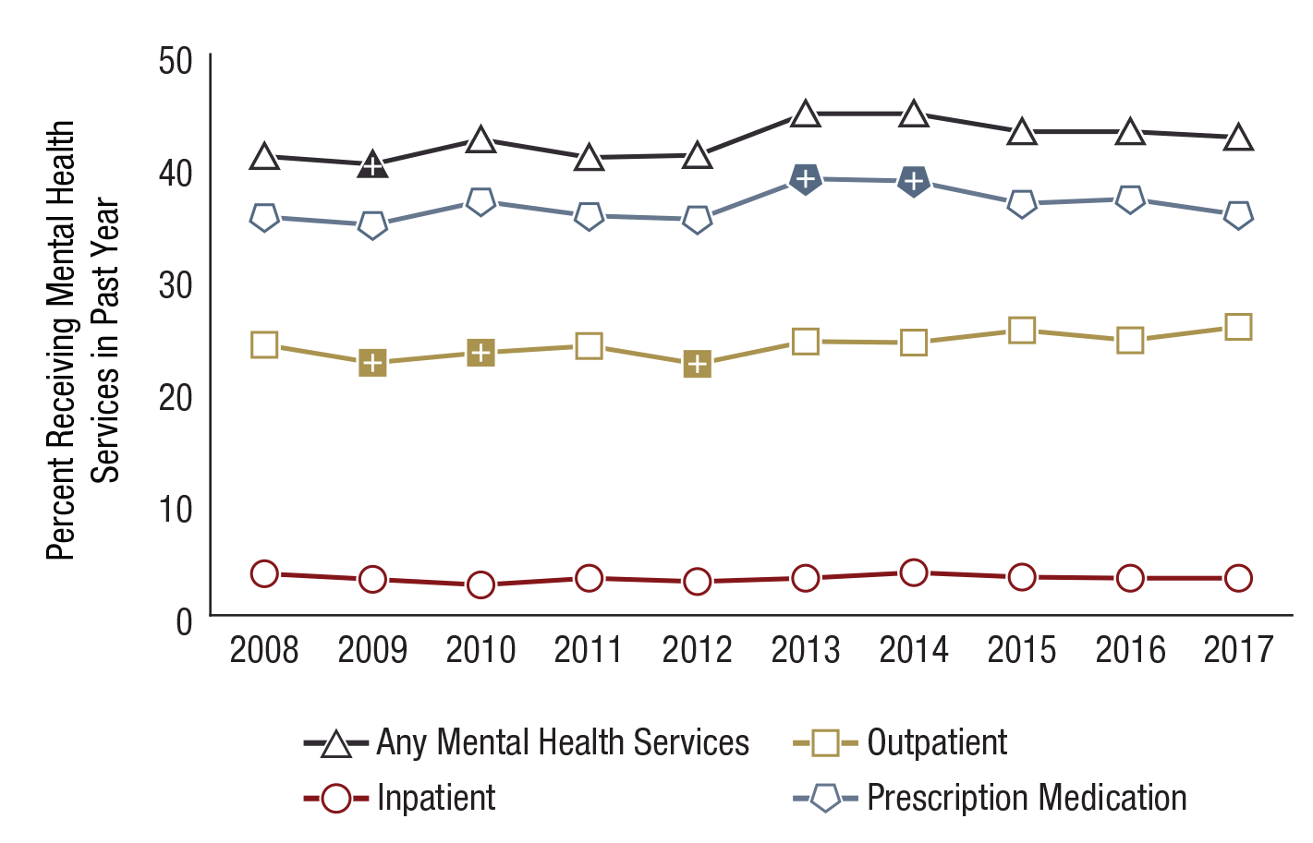
Type of Mental Health Services Received in the Past Year among Adults Aged 18 or Older with Any Mental Illness in the Past Year: Percentages, 2008-2017
FFR1.73
Note: Mental health service is defined as having received inpatient care or outpatient care or having used prescription medication for problems with emotions, nerves, or mental health.
Service Type | 2008 | 2009 | 2010 | 2011 | 2012 | 2013 | 2014 | 2015 | 2016 | 2017
Any Mental Health Service | 40.9 | 40.2⁺ | 42.4 | 40.8 | 41.0 | 44.7 | 44.7 | 43.1 | 43.1 | 42.6
Inpatient | 3.7 | 3.2 | 2.7 | 3.3 | 3.0 | 3.3 | 3.8 | 3.4 | 3.3 | 3.3
Outpatient | 24.1 | 22.5⁺ | 23.4⁺ | 24.0 | 22.4⁺ | 24.4 | 24.3 | 25.4 | 24.5 | 25.7
Prescription Medication | 35.5 | 34.8 | 36.9 | 35.6 | 35.3 | 38.9⁺ | 38.7⁺ | 36.7 | 37.1 | 35.7

Slide 30
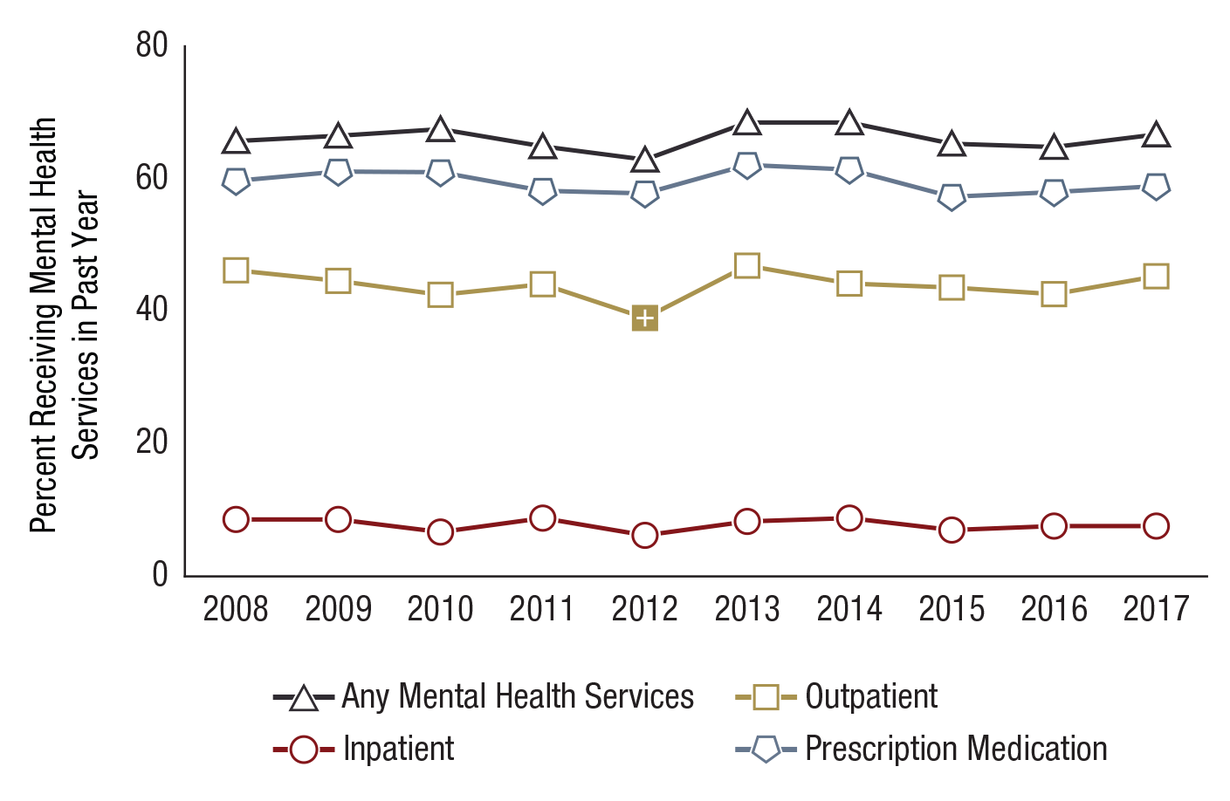
Type of Mental Health Services Received in the Past Year among Adults Aged 18 or Older with Serious Mental Illness in the Past Year: Percentages, 2008-2017
FFR1.74
Note: Mental health service is defined as having received inpatient care or outpatient care or having used prescription medication for problems with emotions, nerves, or mental health.
Service Type | 2008 | 2009 | 2010 | 2011 | 2012 | 2013 | 2014 | 2015 | 2016 | 2017
Any Mental Health Service | 65.7 | 66.5 | 67.5 | 64.9 | 62.9 | 68.5 | 68.5 | 65.3 | 64.8 | 66.7
Inpatient | 8.6 | 8.6 | 6.7 | 8.8 | 6.2 | 8.3 | 8.8 | 7.0 | 7.6 | 7.6
Outpatient | 46.2 | 44.6 | 42.5 | 44.1 | 39.0⁺ | 46.9 | 44.2 | 43.6 | 42.6 | 45.3
Prescription Medication | 59.7 | 61.1 | 61.0 | 58.2 | 57.8 | 62.1 | 61.4 | 57.3 | 58.0 | 58.9

Slide 31
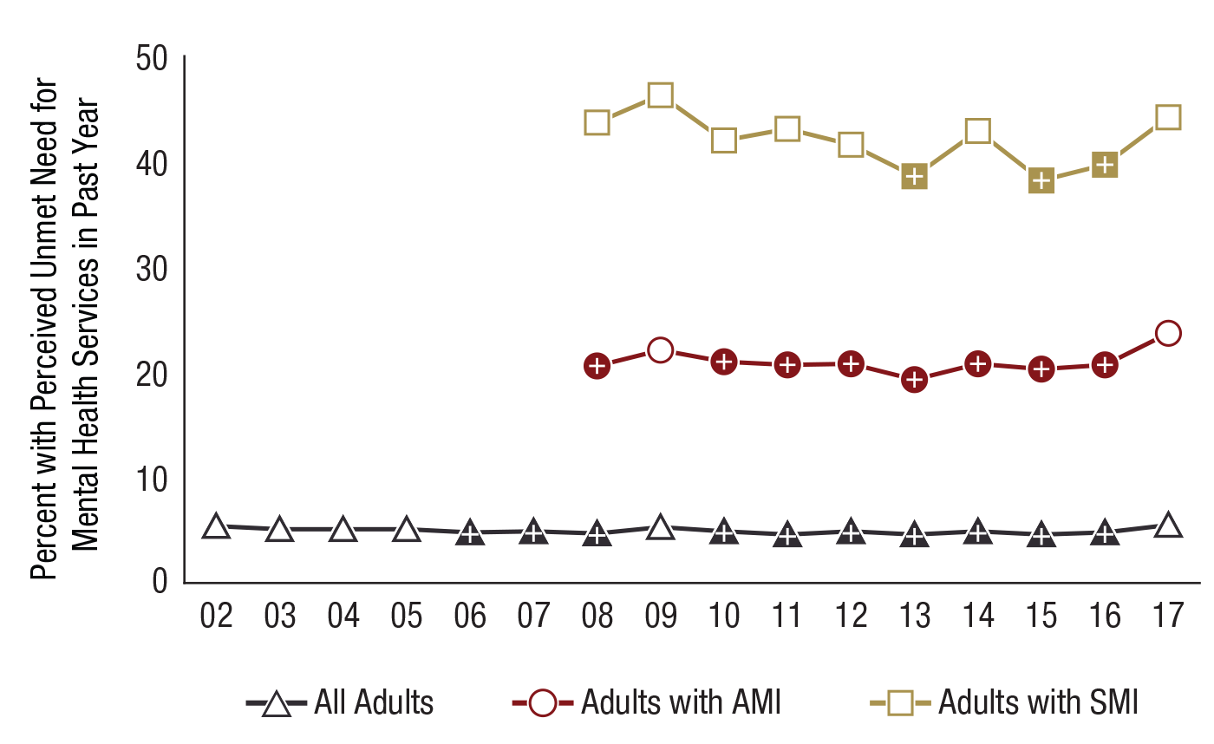
Perceived Unmet Need for Mental Health Services in the Past Year among Adults Aged 18 or Older, by Mental Illness Status: Percentages, 2002-2017
FFR1.75
AMI = any mental illness;
MI = mental illness;
N/A = not available;
SMI = serious mental illness.
MI Status | 2002 | 2003 | 2004 | 2005 | 2006 | 2007 | 2008 | 2009 | 2010 | 2011 | 2012 | 2013 | 2014 | 2015 | 2016 | 2017
All Adults | 5.4 | 5.1 | 5.1 | 5.1 | 4.8⁺ | 4.9⁺ | 4.7⁺ | 5.3 | 4.9⁺ | 4.6⁺ | 4.9⁺ | 4.6⁺ | 4.9⁺ | 4.6⁺ | 4.8⁺ | 5.5
Adults with AMI | N/A | N/A | N/A | N/A | N/A | N/A | 20.6⁺ | 22.1 | 21.0⁺ | 20.7⁺ | 20.8⁺ | 19.3⁺ | 20.8⁺ | 20.3⁺ | 20.7⁺ | 23.7
Adults with SMI | N/A | N/A | N/A | N/A | N/A | N/A | 43.7 | 46.3 | 42.0 | 43.1 | 41.6 | 38.6⁺ | 42.9 | 38.2⁺ | 39.7⁺ | 44.2

